Slide 1
PDAT613G: Data Mining
Module 3B – Visualization

Slide 2
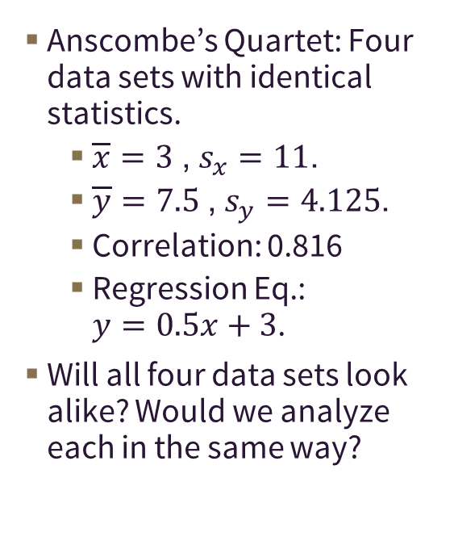
33 – Visualization is a necessary part of data exploration.
Anscombe’s Quartet: Four data sets with identical statistics.
$\overline{x}=3$, $s_{x}=11$.
$\overline{y}=7.5$, $s_{y}=4.125$.
Correlation: 0.816
Regression Eq.: $y=0.5x+3$.
Will all four data sets look alike? Would we analyze each in the same way?

Slide 3
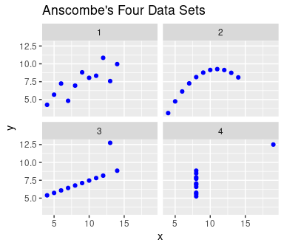

34 – Visualization is a necessary part of data exploration.
Anscombe’s Quartet: Four data sets with identical statistics.
$\overline{x}=3$, $s_{x}=11$.
$\overline{y}=7.5$, $s_{y}=4.125$.
Correlation: 0.816
Regression Eq.: $y=0.5x+3$.
Will all four data sets look alike? Would we analyze each in the same way?

Slide 4
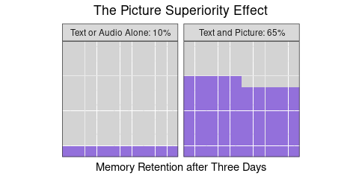
35 – Visualization is an efficient and memorable way to present data.

Slide 5
36 – Visualization can make cognitive tasks easier.
Seeing the big picture.
School ACT.NA ACT.1.16 ACT.17.18 ACT.19.23 1 HARRIS-STOWE 125 71 24 21 2 LINCOLN 21 272 95 115 3 MISSOURI SOUTHERN 99 100 135 321 4 MISSOURI STATE 97 35 93 1165 5 MISSOURI S&T 51 NA 1 83 6 MISSOURI WESTERN 78 162 180 415 7 NORTHWEST 108 37 103 655 8 SOUTHEAST 165 49 163 833 9 TRUMAN 70 1 6 211 10 UCM 65 69 222 868 11 UMC 361 10 51 1643 12 UMKC 67 12 85 368 13 UMSL 29 4 25 197

Slide 6
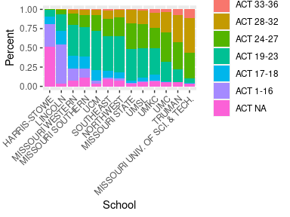
37 – Visualization can make cognitive tasks easier.
Seeing the big picture.

Slide 7
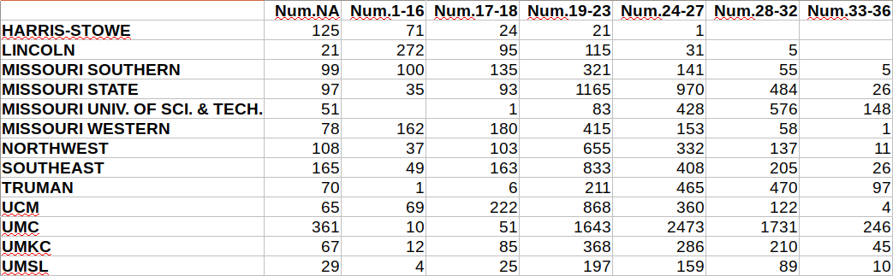
38 – Visualization can make cognitive tasks easier.
Seeing the big picture.
Search and retrieval.

Slide 8
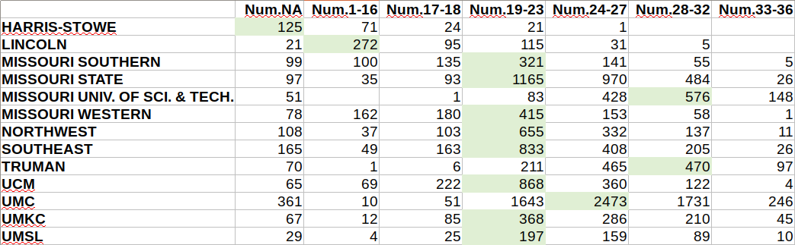
39 – Visualization can make cognitive tasks easier.
Seeing the big picture.
Search and retrieval.

Slide 9
40 – Visualization can make cognitive tasks easier.
Seeing the big picture.
Search and retrieval.
Comparing patterns.
Year TRUMAN UMC All 1 2006 27.300 25.300 22.806 2 2007 27.222 25.400 22.970 3 2008 27.567 25.456 22.998 4 2009 27.206 25.562 23.279 5 2010 27.200 25.750 23.179 6 2011 27.110 25.670 23.298 7 2012 26.900 25.690 23.063 8 2013 27.200 25.680 23.122 9 2014 27.070 25.890 23.422

Slide 10
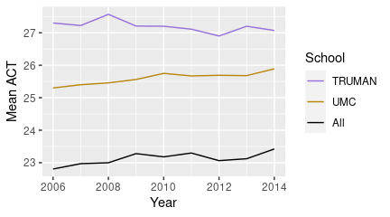
41 – Visualization can make cognitive tasks easier.
Seeing the big picture.
Search and retrieval.
Comparing patterns.

Slide 11
42 – Good data visualization designs…
answer questions of interest,
portray data honestly and accurately,
balance detail and summary,
let the data shine through when possible,
allow easy comparisons between groups or variables,
are often multivariate in nature,
encourage interest through good design, and
are tailored for the target audience.

Slide 12
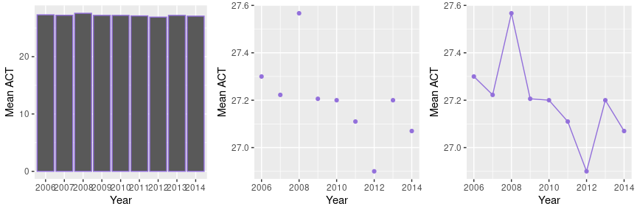
43 – “Dimension” of graphical elements should match that of data.
Means are 0-dimensional points.
To emphasize that points are connected through time, a line graph is appropriate.

Slide 13
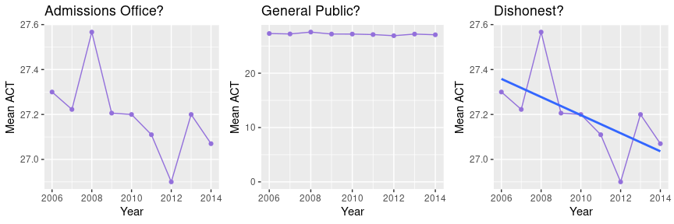
44 – Graphs should honestly display data, consistent with question and audience.
Admissions Office: Cares about small year-to-year changes.
General Public: Cares about overall selectivity, amount of any change vs. overall magnitude.
Dishonest? Too few data points/too much variability. Gives incorrect impression of trend and its magnitude.

Slide 14
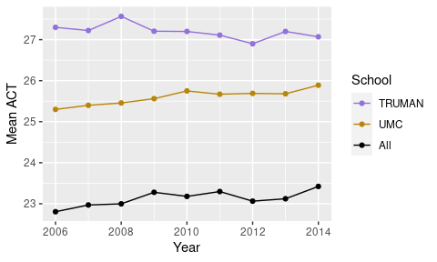
45 – Effective visualizations allow comparison.

Slide 15
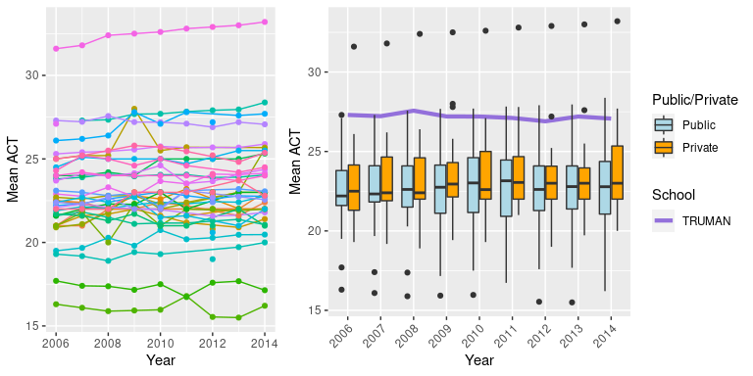
46 – Find a balance between detail and summary.

Slide 16
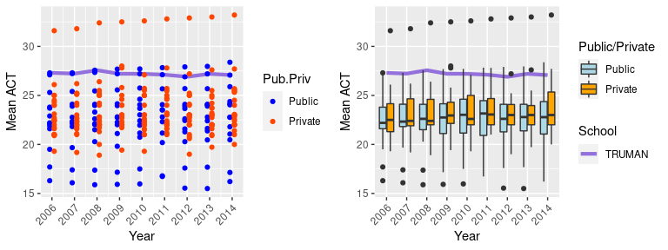
47 – How much should the data shine through?
School labels would be nice, or too much?
If labels could pop up on mouse-over, would your preference change?

Slide 17
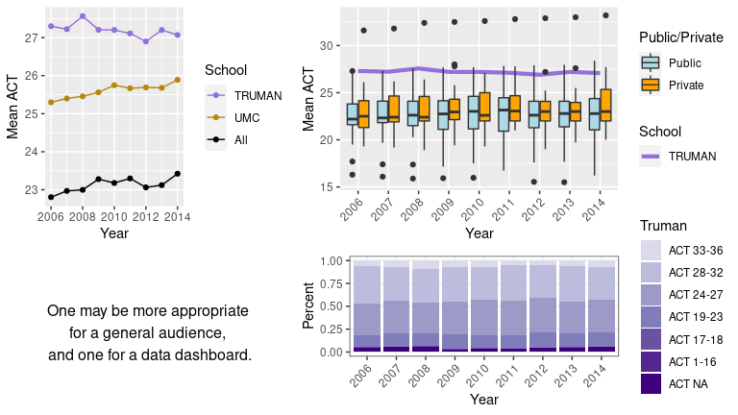
48 – Data density may be dictated by target audience.

Slide 18
49 – Further Reading
The Visual Display of Quantitative Information, Edward R Tufte. A classic. Tufte definitely has a point of view in the later chapters, but it’s an interesting read. He has published several more books that take on different aspects of visualization, which are also interesting.
Introduction to Data Science, Rafael A. Irizarry A freely-available data science text that has good information and a nice chapter on visualization. https://rafalab.github.io/dsbook/data-visualization-principles.html

Slide 19
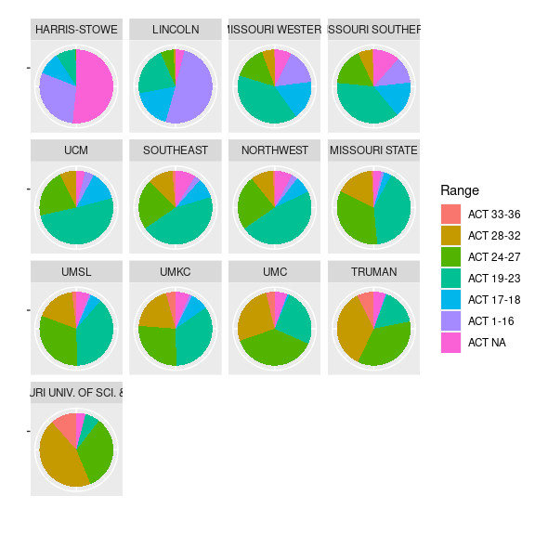
50 – Question
Consider the data visualization at right. Which of the following principles of good design might it be violating? (Of course, this might be a more subjective question than some.)
Allows easy comparisons
Represents multiple variables
Answers a question of interest
Represents data accurately

Slide 20
51 – Interactive data dashboards allow wider access to important data.
Business Analytics:
Net revenue and contributing factors
Sales trends
Server/IT performance
Supply chain
Health Care/Public Health
Tracking patient outcomes
Change in public health measurs over time.
Education
Student performance
Attendance/Absenteeism
Others: News organizations, nonprofits, religious organizations, etc.

Slide 21
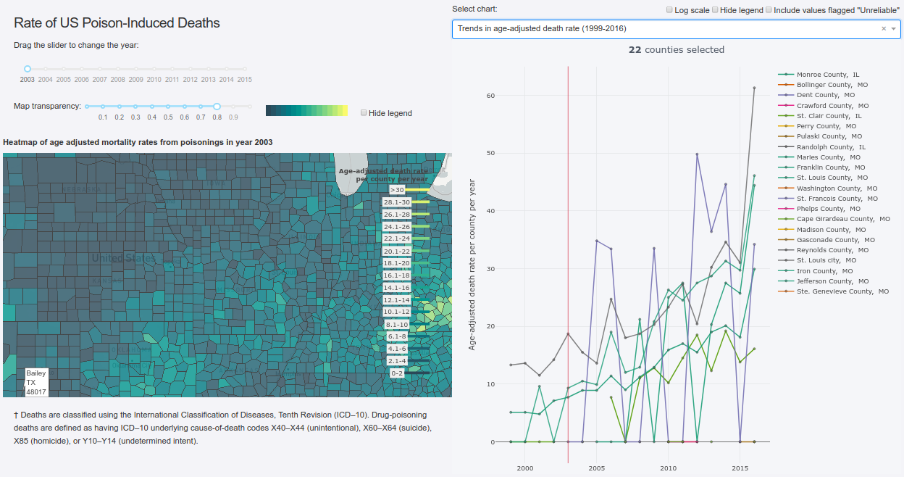
52 – Opioid Deaths
Link to the opioid dashboard. (plotly.host)

Slide 22
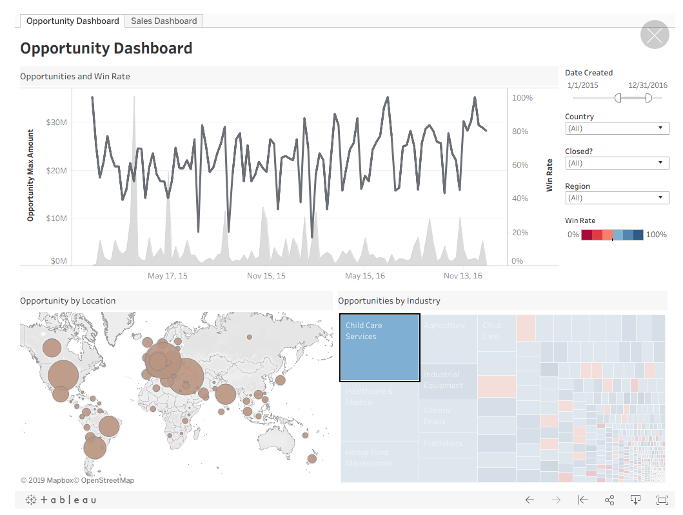
53 – Sales Dashboard from Tableau
Link to the sales dashboard (tableau.com)

Slide 23
54 – Try some examples of interactive visualization!
Gapminder produces interactive visualizations related to issues of global health and development. https://www.gapminder.org/
Plotly produces open-source graphing libraries as well as commercial offerings. Their demo gallery can be fun to explore. https://dash.plot.ly/gallery
Similarly, the makers of RStudio bring you shiny apps. https://shiny.rstudio.com/gallery/
Many commercial offerings and “success stories” are a Google search away.

